Slide 1
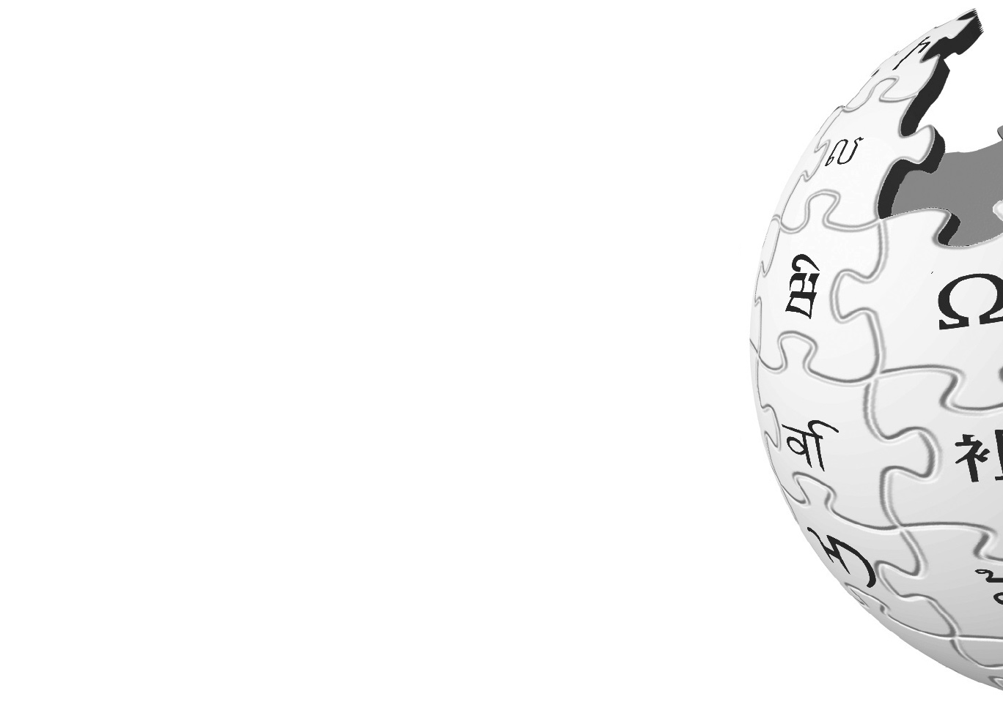
Wikipedia Cultural Diversity Observatory
(WCDO)
[https://meta.wikimedia.org/wiki/WCDO]
Marc Miquel, PhD
{marcmiquel@gmail.com}
Username:marcmiquel
Pompeu Fabra University, Barcelona, Catalonia
Amical Wikimedia (Catalan Wikipedia)
Lviv, Ukraine 2018

Slide 2
In 2010, I got interested in Wikipedia, especially when I realized that each language has different content.
So I decided to study it.

Slide 3

How is my culture represented in Wikipedia?
Notes:
Slide 2. My story. Self-focus (2011). Autoreferentiality (2011). Catalan culture (2012). CIRA (2015).... Then, I realized of the imbalances.
Every academical opportunity to study Wikipedia, until I finished my doctoral dissertation.
Autoreferentiality (2010). Bachelor Thesis.
Catalan culture (2012). Master Thesis.
CIRA (2015). PhD Thesis.
CCC (2018).
I realized my problem (or the Catalan one) was much more extensive than I ever thought. Knowledge inequalities and representation.
my goal is to help each culture of the world being represented.

Slide 4
The Problem
Wikipedia project does not reflect enough the world’s cultural diversity.
Some voices are missing or underrepresented

Slide 5
”Knowledge equity: As a social movement, we will focus our efforts on the knowledge and communities that have been left out by structures of power and privilege. We will welcome people from every background to build strong and diverse communities. We will break down the social, political, and technical barriers preventing people from accessing and contributing to free knowledge."
2030 Strategic direction, Wikimedia Foundation
https://meta.wikimedia.org/wiki/Strategy/Wikimedia_movement/2017/Direction
Notes:
Slide 3. Knowledge equity. Other people's stories. Represent all languages.

Slide 6
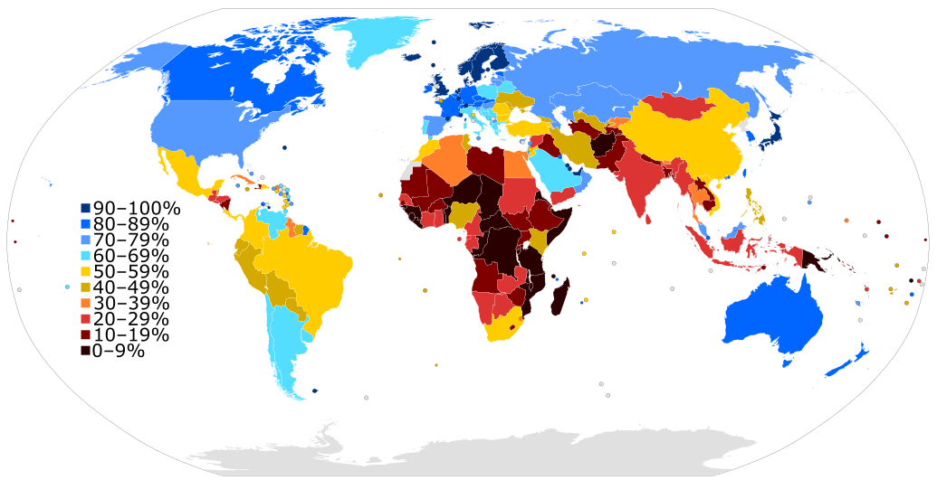
Many articles that should describe the world’s cultural diversity do not exist because not everyone has a Wikipedia, or cannot contribute to it.
We know that this is due to many factors such as the digital divide, language reputation, among others.
Van Dijk, Z. (2009). Wikipedia and lesser-resourced languages. Language Problems and Language Planning, 33(3), 234-250.
Digital divide

Slide 7
Some articles that represent the cultural particularities and contexts specificities exist... But nobody outside their local Wikipedia knows about them.
This is where we can actually work.
This is how I hope I can help CEE Spring.

Slide 8
Proposed Solution
Wikipedia Cultural Diversity Observatory (WCDO).
“a joint space for researchers and activists to study and fight against the knowledge gaps and promote knowledge equity.”
Awareness
Solutions
http://wcdo.wmflabs.org (beta 1)
Notes:
I am going to show you… the very first Beta.
I need your feedback.
I believe that raising awareness is empowering people to act different,
to act as a group...
once people have this information they cannot act as if they don't.
per la presentació

Slide 9
It is impossible to bridge all the knowledge gaps between languages.
Notes:
In my research, I selected the content related to the cultural contexts of the editors from each language version, and then I studied characteristics such as topics and availability between linguistic versions, the editing activity, among others.
I found that the Cultural Context Content (CCC) represents on average a quarter of each Wikipedia language edition, dealing with topics such as culture, politics, people or geography of its speaking territories.

Slide 10
WCDO Main goal
“Every Wikipedia language edition ensures a minimal coverage of each other language cultural and geographical content.”
Notes:
In my research, I selected the content related to the cultural contexts of the editors from each language version, and then I studied characteristics such as topics and availability between linguistic versions, the editing activity, among others.
I found that the Cultural Context Content (CCC) represents on average a quarter of each Wikipedia language edition, dealing with topics such as culture, politics, people or geography of its speaking territories.

Slide 11
I propose every Wikipedia has 100 articles about every other language’s cultural and geographical content.
This is 28-30 thousand articles.
Notes:
In my research, I selected the content related to the cultural contexts of the editors from each language version, and then I studied characteristics such as topics and availability between linguistic versions, the editing activity, among others.
I found that the Cultural Context Content (CCC) represents on average a quarter of each Wikipedia language edition, dealing with topics such as culture, politics, people or geography of its speaking territories.

Slide 12
Top CCC articles lists
From each language, those articles from their cultural context which are more relevant according to specific features:
List = [editors, featured, geolocated, keywords, women, men, created_first_three_years, created_last_year, pageviews, discussions]
Country_origin (optional) = ISO3166 code
Lang_origin = wikicode
Lang_target = wikicode
http://wcdo.wmflabs.org/top_ccc_articles/?list=men&lang_origin=pl&lang_target=uk
Notes:
In my research, I selected the content related to the cultural contexts of the editors from each language version, and then I studied characteristics such as topics and availability between linguistic versions, the editing activity, among others.
I found that the Cultural Context Content (CCC) represents on average a quarter of each Wikipedia language edition, dealing with topics such as culture, politics, people or geography of its speaking territories.

Slide 13
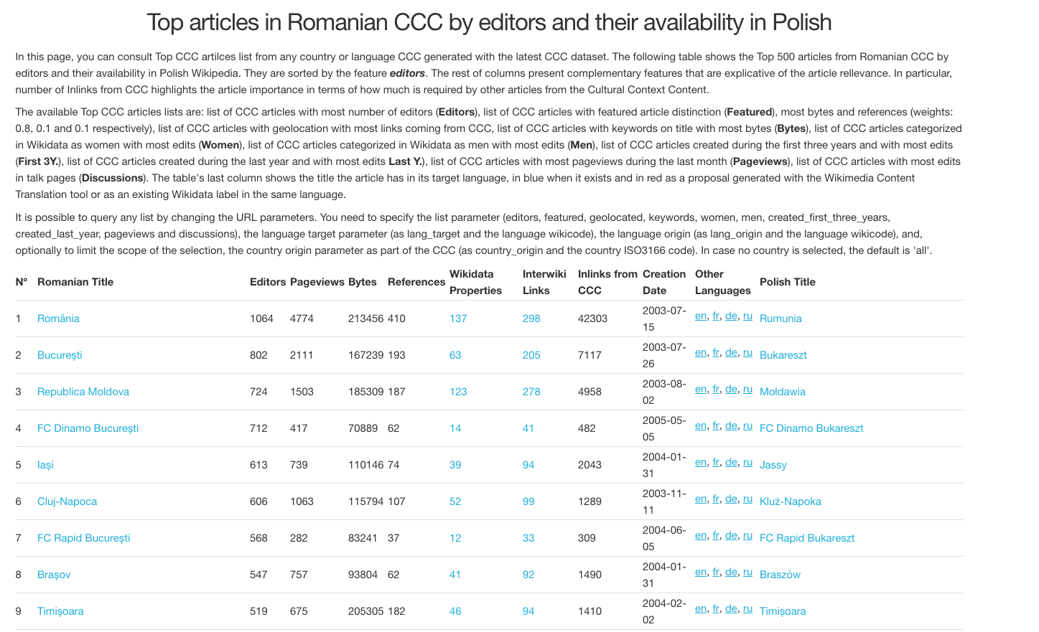
Notes:
I want Wikipedia to be much more multicultural and every voice represented. WCDO.

Slide 14
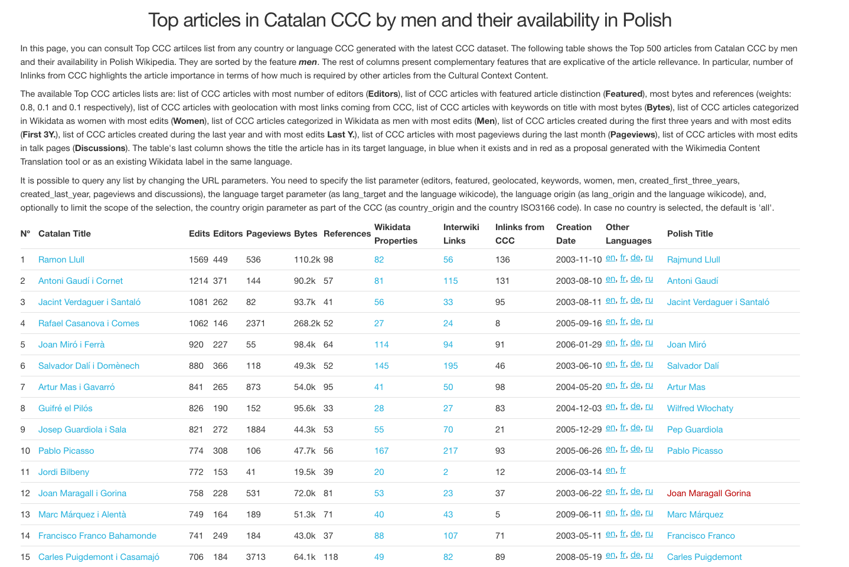
Notes:
here is a list of Catalan Articles.
these are the results.... 100 articles from every language cultural context.
now i could leave the door and you would have something to work on.
why is that? why are there these *errors*
it is hard to differentiate what is us, and what made us like we are (even though we do not accept it).
in other words, the method is based on relations

Slide 15
Why was there such interference?
Let me explain you the whole story about CCC…
Notes:
In my research, I selected the content related to the cultural contexts of the editors from each language version, and then I studied characteristics such as topics and availability between linguistic versions, the editing activity, among others.
I found that the Cultural Context Content (CCC) represents on average a quarter of each Wikipedia language edition, dealing with topics such as culture, politics, people or geography of its speaking territories.

Slide 16
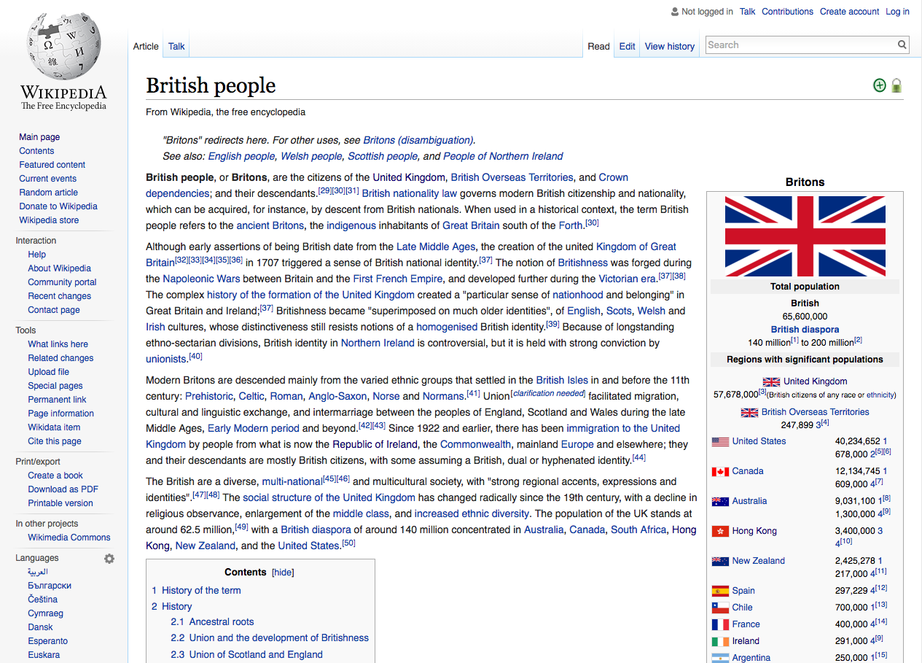
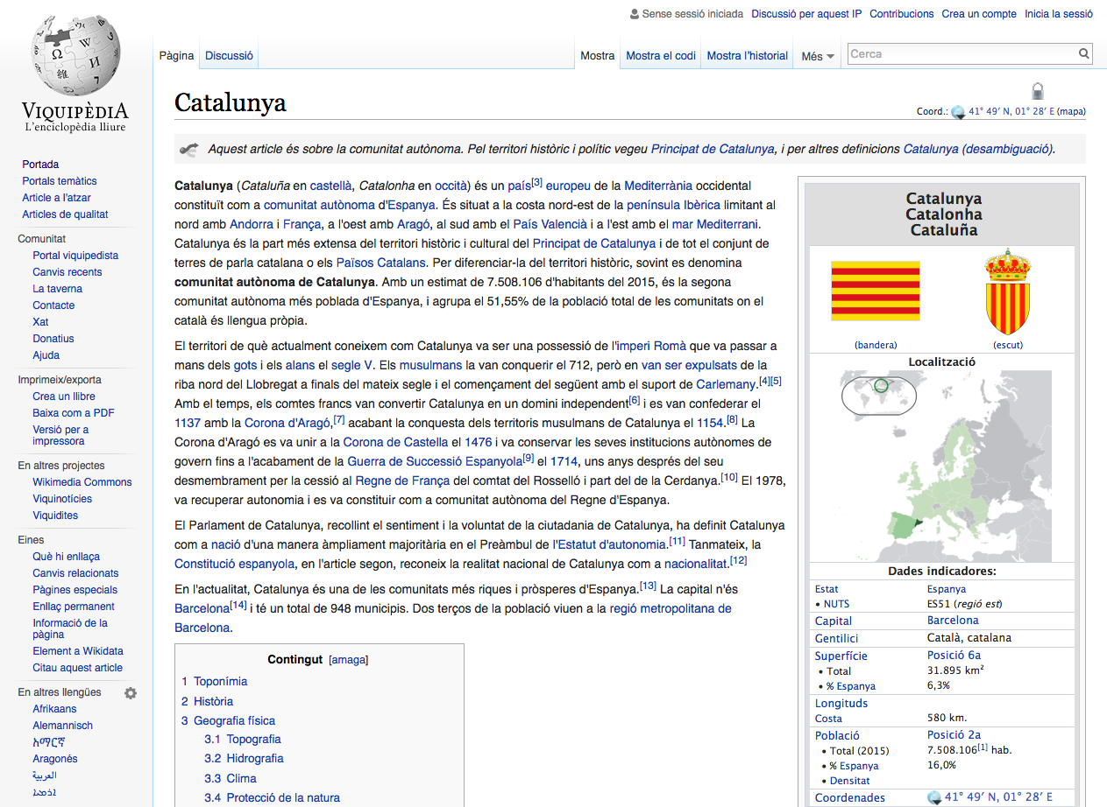
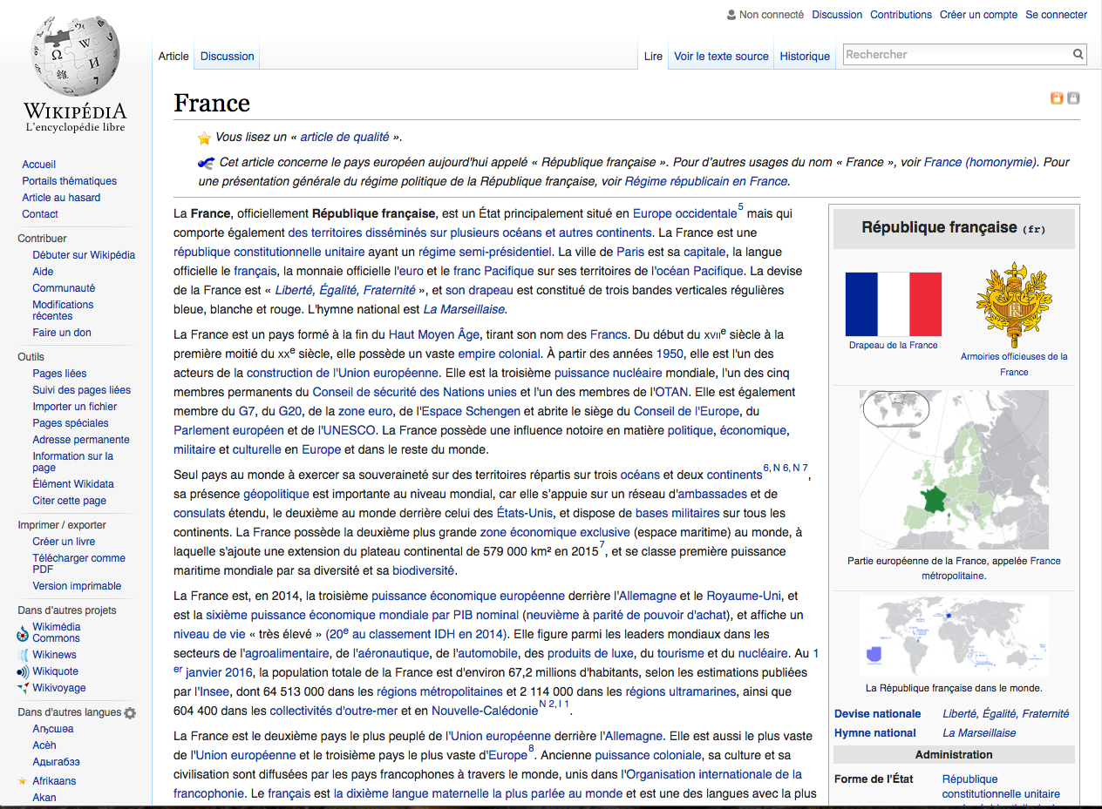
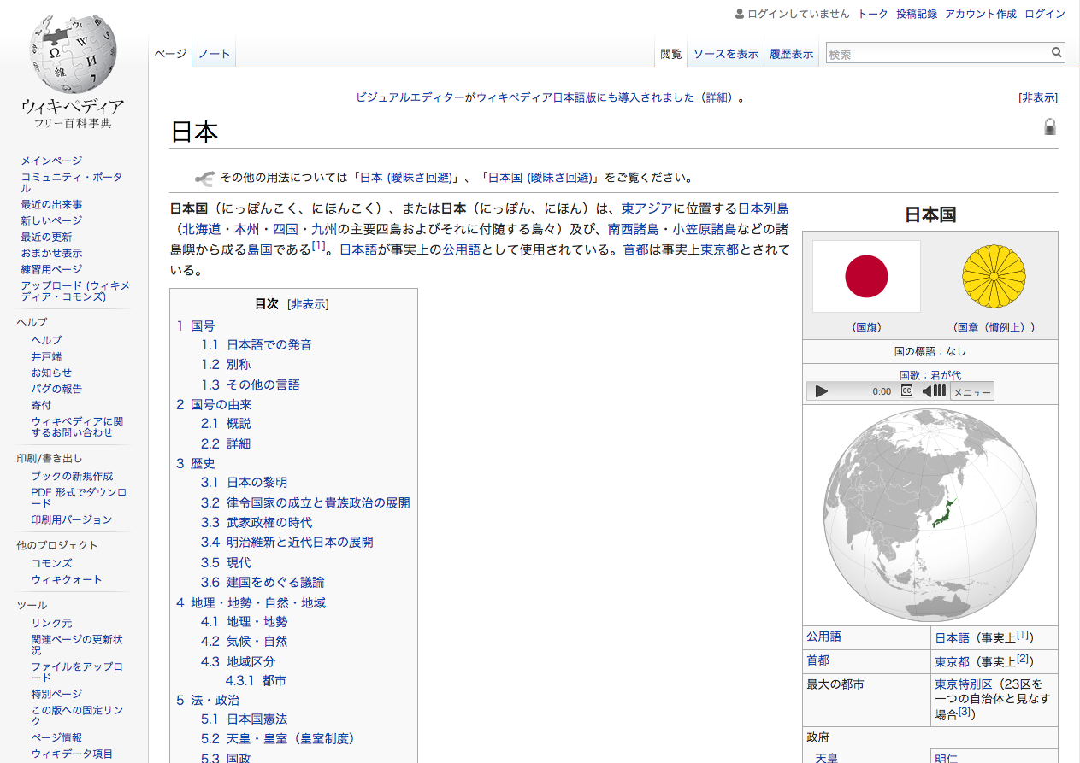
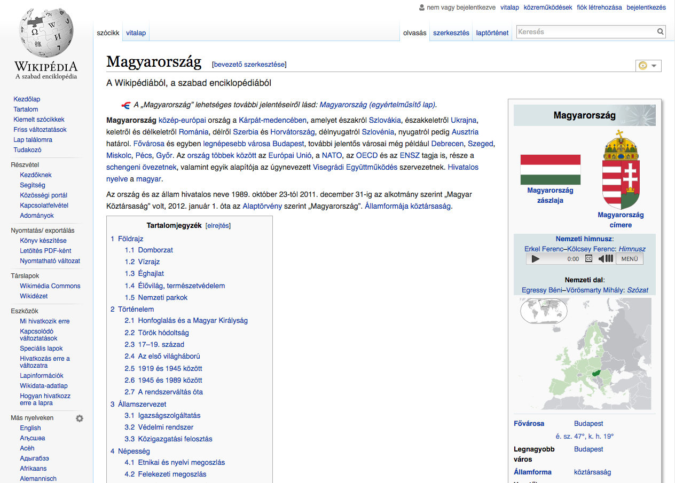
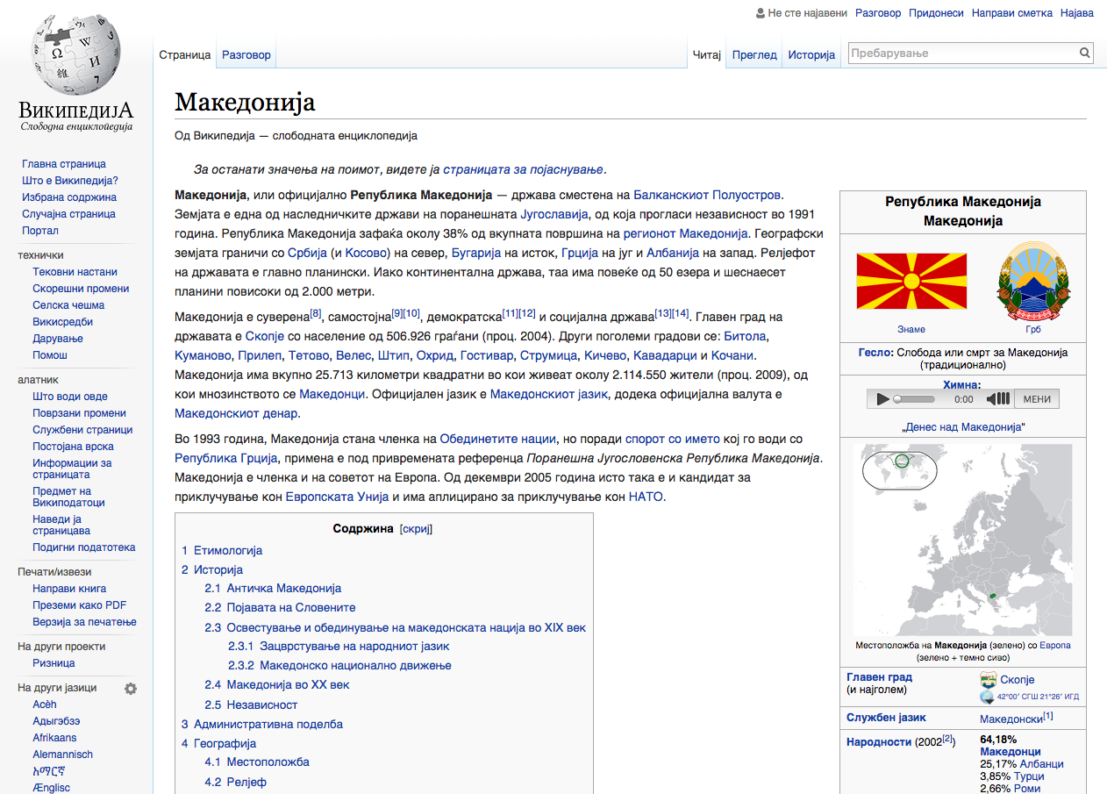
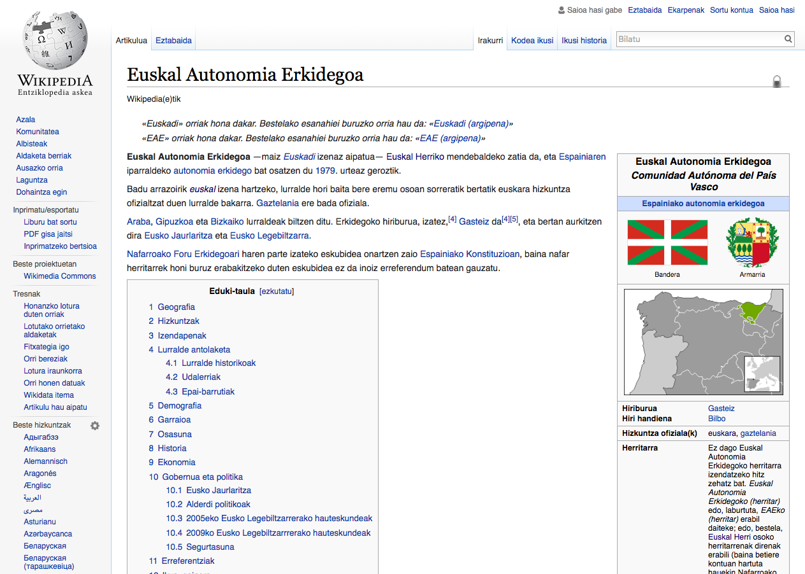
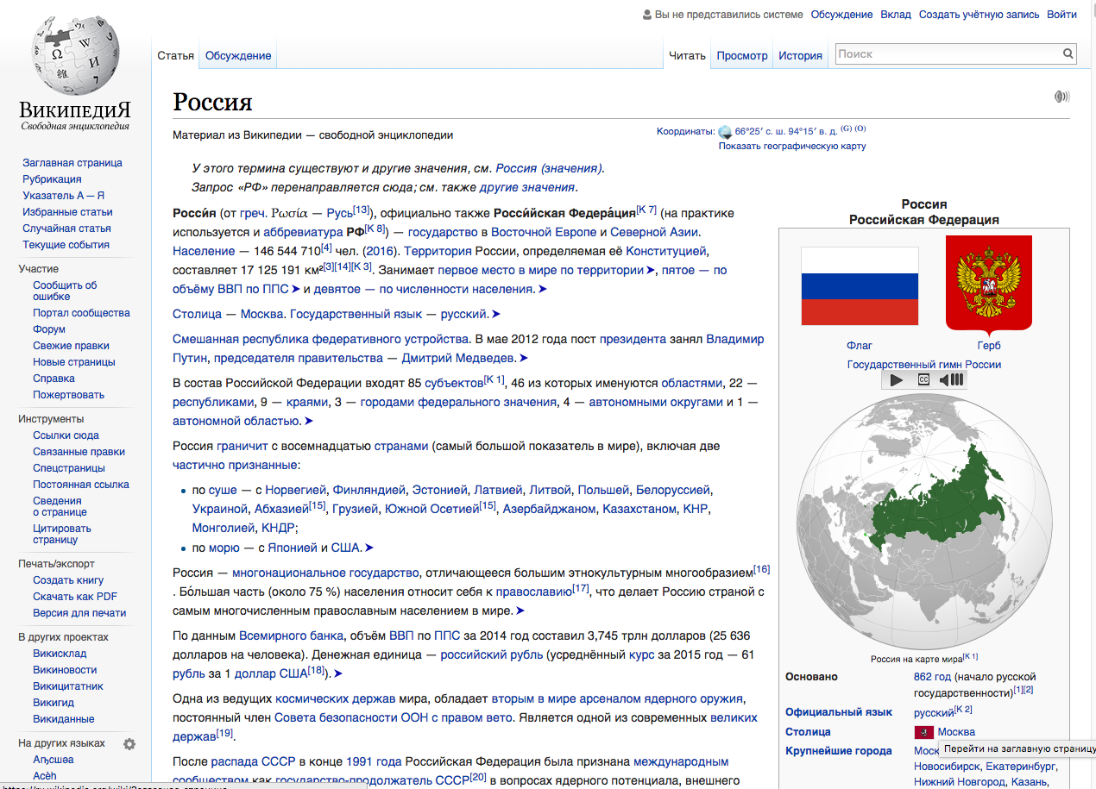
In this research:
We select the Cultural Context Content (CCC), i.e. the articles related to the editors’ cultural contexts in each language edition (traditions, language, politics, agriculture, biographies, places, events, etcetera).
This means associating each language to the territories where it is spoken officially or where is native, and then, collecting articles that relate to each territory.
Notes:
In my research, I selected the content related to the cultural contexts of the editors from each language version, and then I studied characteristics such as topics and availability between linguistic versions, the editing activity, among others.
I found that the Cultural Context Content (CCC) represents on average a quarter of each Wikipedia language edition, dealing with topics such as culture, politics, people or geography of its speaking territories.

Slide 17
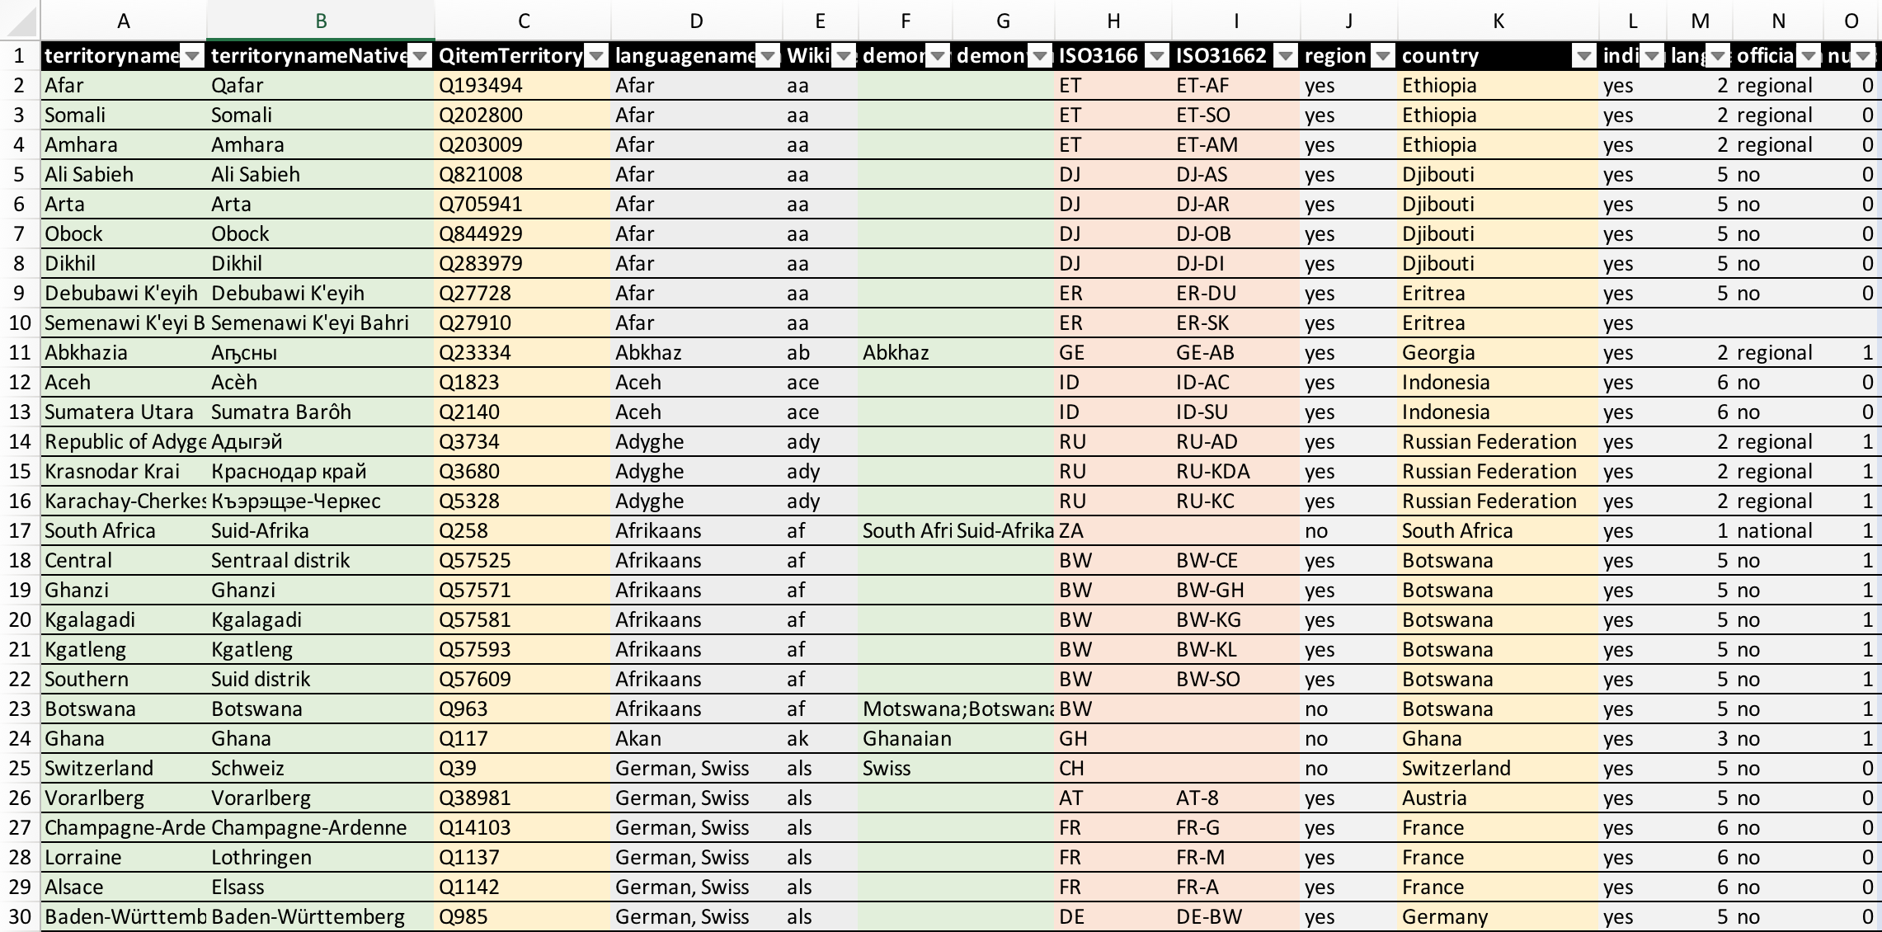
3. Methodology
ccc_setup_language_context_mapping.py
This requires (i) creating a database with Language-Territories Mapping and (ii) employing different retrieval strategies to extract content from each language edition and label it as CCC.
(i) Wikidata Language Qitem, Language name, Language name in Native language, the ISO 639 code, the associated territories at country level (ISO 3166 code, English name, Native language name, demonym, Qitem) or at first subdivision (ISO 3166-2 code, English name, Native language name, demonym, Qitem) according to the information generated by Ethnologue.
Language Territories mapping spreadsheet with 1783 rows.
https://wcdo.wmflabs.org/language_territories_mapping/

Slide 18
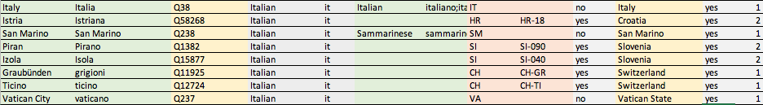
For example:
(i) Wikidata Language Qitem, Language name, Language name in Native language, the ISO 639 code, the associated territories at country level (ISO 3166 code, English name, Native language name, demonym, Qitem) or at first subdivision (ISO 3166-2 code, English name, Native language name, demonym, Qitem) according to the information generated by Ethnologue.
Territories where the language is spoken as native or with official status
https://wcdo.wmflabs.org/language_territories_mapping/

Slide 19
ccc_selection.py
(ii) The different retrieval strategies to extract content from each language edition and label it as CCC are the following.
We create a database as rich as possible.
Wikipedia articles with characteristics such as:
Geolocation coordinates
Specific keywords on their titles (language name, territory name, and demonym).
Contained in categories with keywords on their titles or in categories contained by these (in an iterative category graph crawling).
Wikidata Items that relate to groups of properties such as: Language, Location, Country, Part of, In relation with, …
Wikipedia MySQL db Replicas
Wikidata JSON dump
https://meta.wikimedia.org/wiki/Wikipedia_Cultural_Diversity_Observatory/Cultural_Context_Content
Notes:
as this might help to see what is valuable in this language edition.

Slide 20
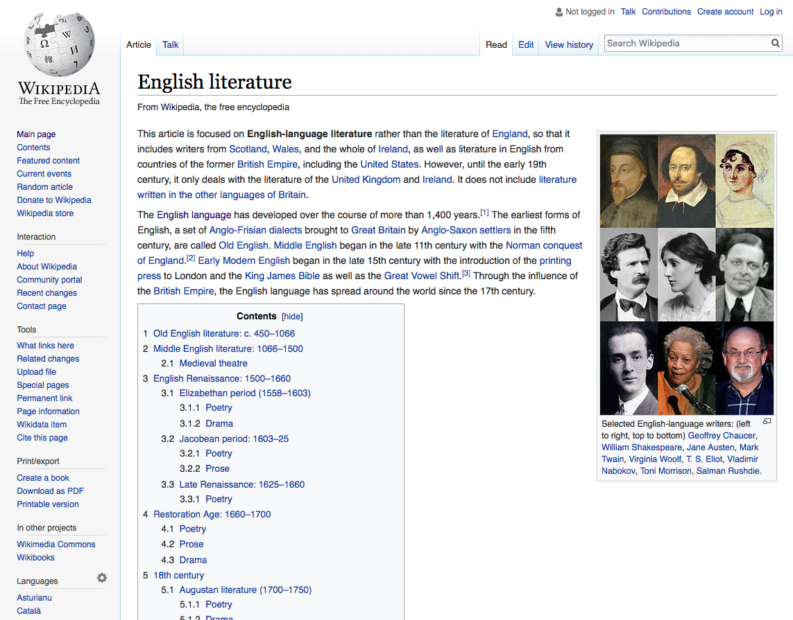
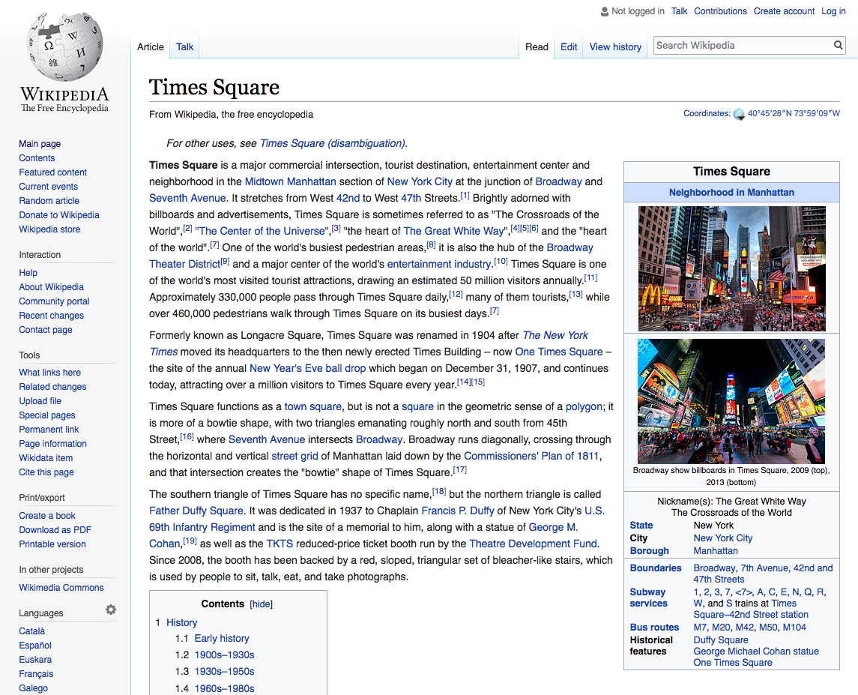
Some of these features are reliable CCC, while some other are potential CCC.
Keyword (demonym/territory name) on title is Reliable CCC
Geolocation in one of the territories is Reliable CCC
Notes:
as this might help to see what is valuable in this language edition.

Slide 21
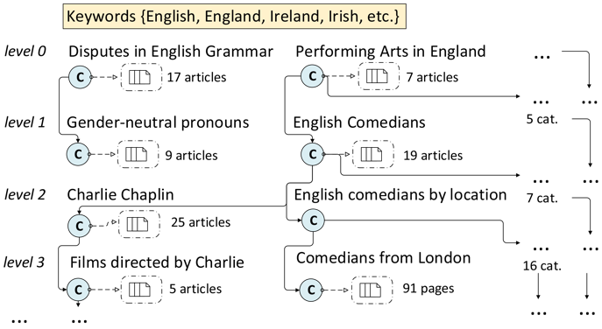
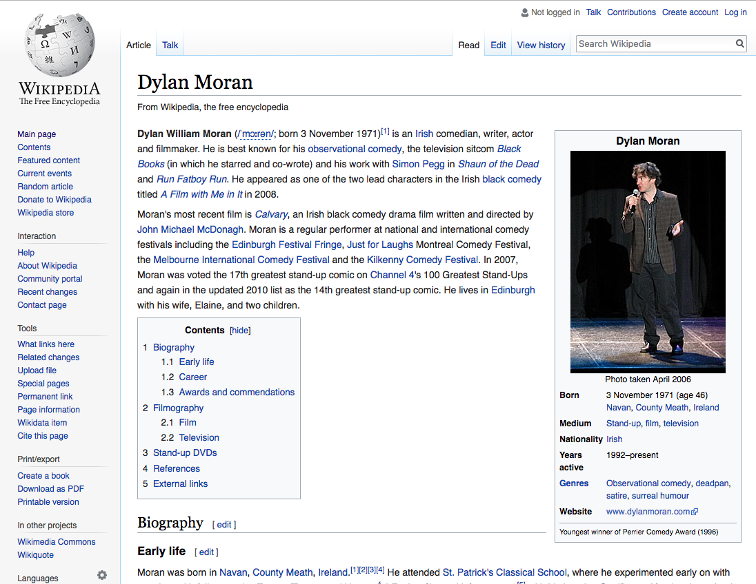
Category crawling using keywords
Being in a subcategory of a category containing a keyword on its title is potential CCC
Notes:
as this might help to see what is valuable in this language edition.

Slide 22
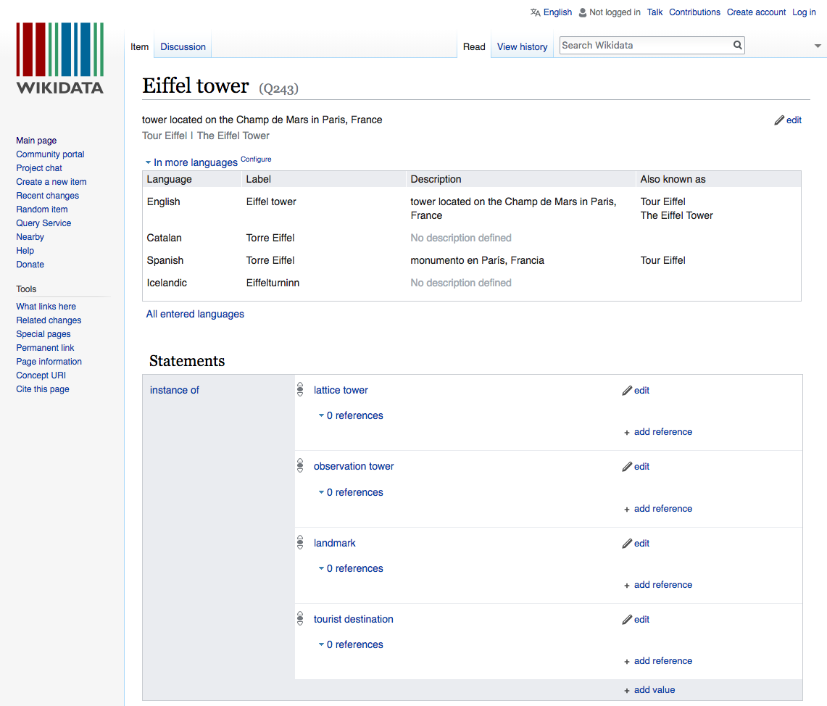
Some Wikidata properties are reliable CCC
Location properties (location, located in administrative,…).
Country properties (country of citizenship, of origin).
Language properties (official language, native language…).
Some Wikidata properties are potential CCC
Affiliation properties (member of, educated at, employer,…).
Has part (contains administrative entity, has part).
Language properties (language of work, language used,…).
With those labelled as potential CCC we cannot be sure how representative the feature is to be included as Cultural Context Content.
Notes:
as this might help to see what is valuable in this language edition.

Slide 23
Links feature:
Number and percentage of Inlinks/Outlinks (incoming/outgoing links) to CCC is very explicative on how an article is needed to expand CCC or is dedicated to CCC.
Some negative features:
Geolocated articles not in CCC (reliable not in CCC)
Other CCC Wikidata properties (potential not in CCC)
Other Language CCC Category Crawling (potential not in CCC)
Number and Percentage of Inlinks/Outlinks to geolocated articles not in CCC (potential not in CCC)
With the features we establish a groundtruth (articles we know they already are CCC and articles we know they are not CCC).
Notes:
as this might help to see what is valuable in this language edition.

Slide 24
MACHINE LEARNING CLASSIFIER
We have a rich database with all the articles of all the Wikipedias with these features.
Those tagged with a strong feature are considered the Cultural Context Content groundtruth. We are sure they are CCC.
For every Wikipedia article we compute the number of incoming and outgoing links to the CCC groundtruth, as well as the percent they represent from the total number of incoming and outgoing links.
RANDOM FOREST Classifier (implemented using scikit-learn).
Training Data: The Cultural Context Content groundtruth as a positive training set. while the rest of articles (some tagged with other features such as category crawling, wikidata properties and some untagged) are sampled 10x and introduced as negative training set. This is called Negative Sampling.
Testing Data: We take those which have at least one CCC feature (weak ones: category crawling and some wikidata properties) and test them against the classifier in order to obtain the good ones.
The positive articles from the classifier and the initial CCC groundtruth constitute the final CCC.
We run a manual assessment (blind) to determine the quality of the selection and the results were in average a 5% false positive and 5% false negative.
Notes:
as this might help to see what is valuable in this language edition.

Slide 25
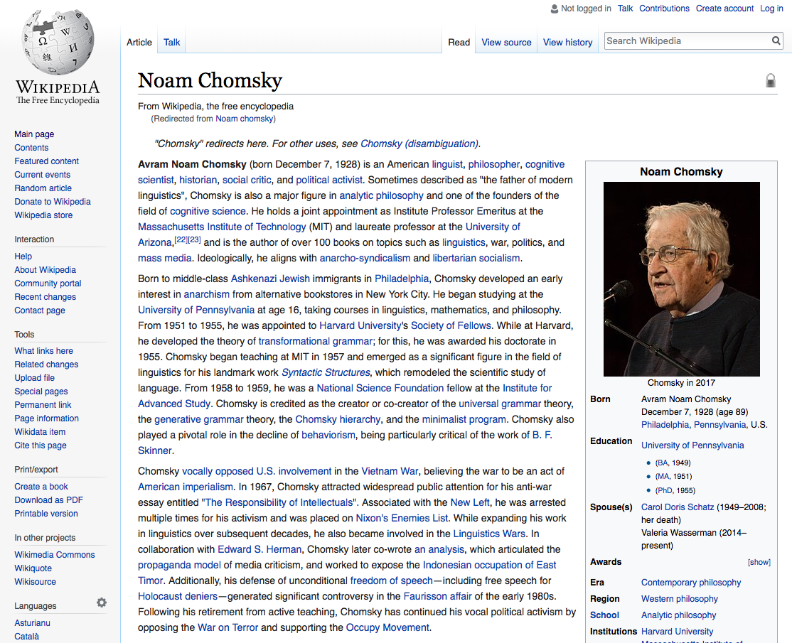
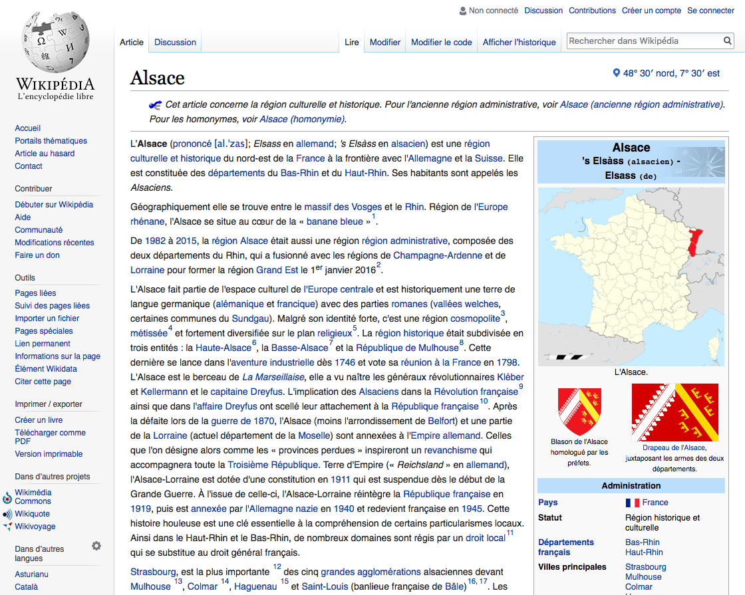
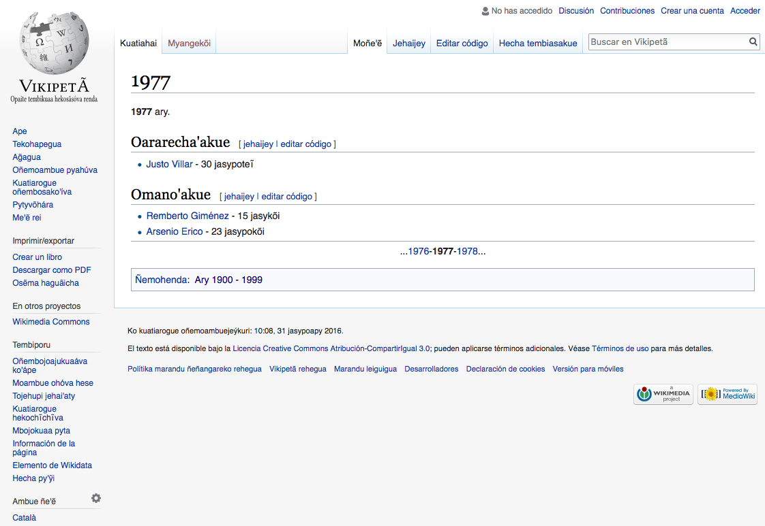
CCC IS A CONTINUUM
Should Chomsky be in Catalan CCC?
He received a Catalan Gov. prize but…
What about Leo Messi?
Should Alsace be part of the German CCC?
It used to be part of the German Empire
Year 1977 should not be part of Guarani CCC,
Even the article in this language contains only events related to Guarani CCC…
The classifier ‘decides’ whether it should be in or not according to the features.
Not enough outlinks to CCC or no category from the category crawling? Probably out.
Notes:
as this might help to see what is valuable in this language edition.

Slide 26
Project’s Technical Overview
Wikimedia Cloud Server at Toolforge
Server: https://tools.wmflabs.org/admin/tool/wcdo
Execution: crontab (cron job in shell) to execute the scripts on a monthly basis.
Python scripts:
ccc_setup_language_context_mapping.py (it creates the language territories equivalences database).
ccc_selection.py (it creates the main database ccc_current.db and the datasets).
stats_generation.py (it creates the database wcdo_data.db with the main statistics).
meta_update.py (it updates stats in meta with pywikibot and in the website).
Datasets
They are available at wcdo.wmflabs.org/datasets and at figshare.com/account/home#/projects/28272
Code in Github
All the code, presentation and files are at: github.com/marcmiquel/WCDO
Do you want to join? E-mail me at marcmiquel@gmail.com
Phabricator: https://phabricator.wikimedia.org/T193984
Notes:
as this might help to see what is valuable in this language edition.

Slide 27
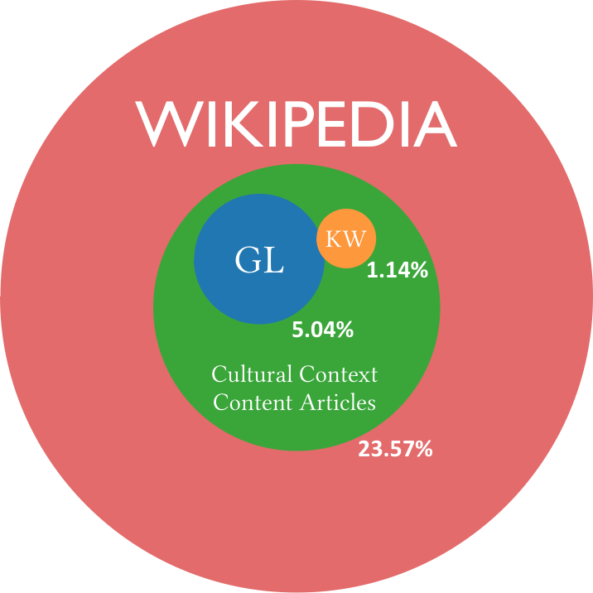
Taking into account the main languages, CCC is about a quarter of the Wikipedia.
CCC articles percentage is very variable.

Slide 28
What is the extent of this language CCC?
List of Wikipedias by Cultural Context Content
List of Language Territories by Cultural Context Content
http://wcdo.wmflabs.org/list_of_wikipedias_by_cultural_context_content
http://wcdo.wmflabs.org/list_of_language_territories_by_cultural_context_content

Slide 29
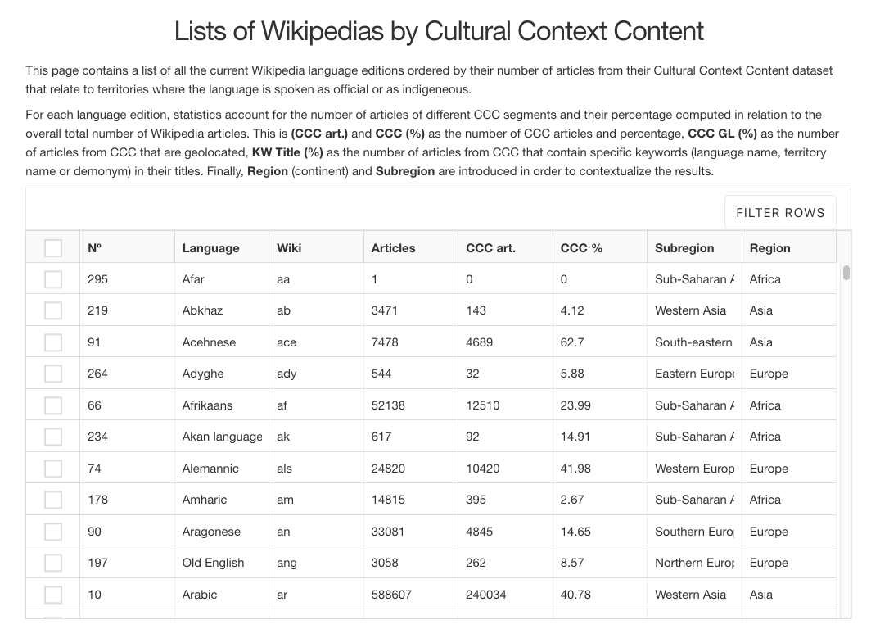

Slide 30
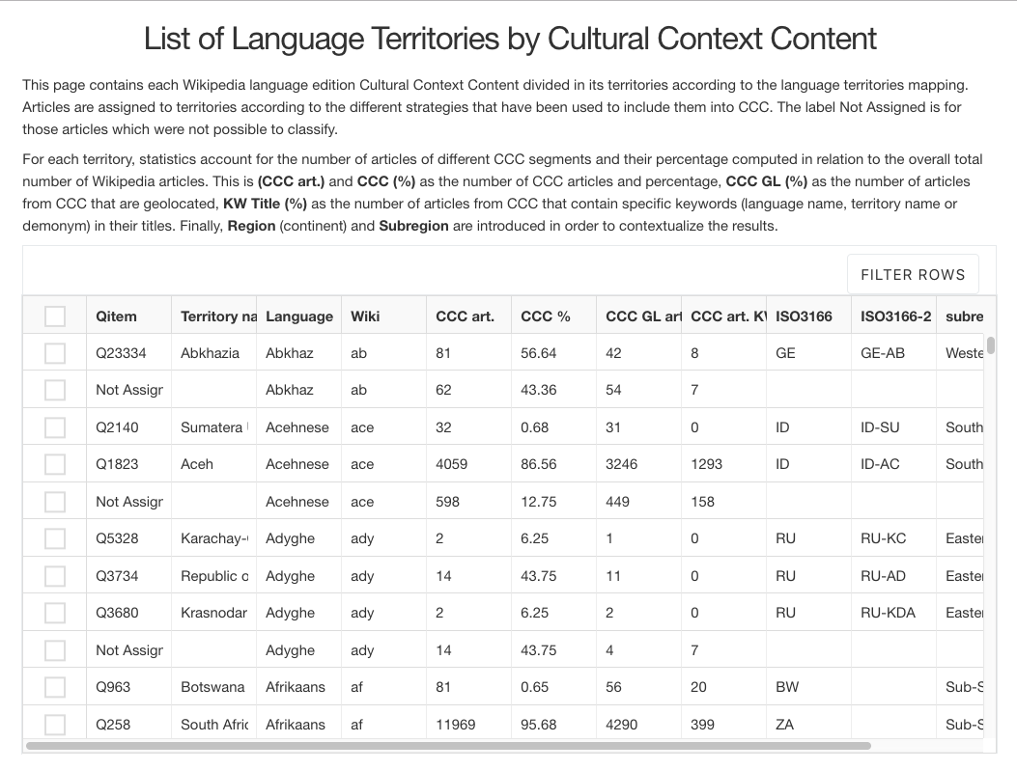

Slide 31
Few results from the List of the Wikipedias and territories:
CCC % is not related to language size.
Bot-created Wikipedias CCC % is very low.
From CEE, biggest are Crimean Tatar, Taraškievica and Russian, which oscillate between 32-44%.
Imperial languages tend to have a high CCC % (English has).
Dutch and Swedish Wikipedias are big and dilute the CCC%.
Isolated cultures like Japanese has also a high CCC %.
And the most important…

Slide 32
The extent of CCC from certain language editions is too little (non-western, especially African and Asian).
Each Wikipedia editors are the ones who can explain their context in its the best way.
CCC articles tend to be more developed. Editors tend to have more access to the sources of information, know the difference points of view on the same topic, among other reasons.
Notes:
In my research, I selected the content related to the cultural contexts of the editors from each language version, and then I studied characteristics such as topics and availability between linguistic versions, the editing activity, among others.
I found that the Cultural Context Content (CCC) represents on average a quarter of each Wikipedia language edition, dealing with topics such as culture, politics, people or geography of its speaking territories.

Slide 33
INTERSECTIONS AND INCREMENTS
Once the CCC dataset is obtained, we can compute the different intersections with other groups in order to understand its extent and scope.
Main entities:
CCC Segments (Geolocated, those with keywords on title)
People (Men and Women)
Geolocated articles (Continents, world regions and countries)
Articles without interlanguage links
All Wikipedia articles
…
Notes:
Slide de metodologia (després de l’slide de ccc_selection.py, després un slide de stats_generation). stats_generation.py és intersections i increments. Les Main Coverign Entities. Main Covered Entities.

Slide 34
What articles do languages have in common?
Notes:
In my research, I selected the content related to the cultural contexts of the editors from each language version, and then I studied characteristics such as topics and availability between linguistic versions, the editing activity, among others.
I found that the Cultural Context Content (CCC) represents on average a quarter of each Wikipedia language edition, dealing with topics such as culture, politics, people or geography of its speaking territories.

Slide 35
Culture Gap: most CCC articles not available across languages
About a 60% of the content language gaps are due to CCC.
Big languages like English or geographically close languages are the ones covering best the smaller languages.
Notes:
Most importantly, around a 50% of CCC articles are unique to each language version and do not exist in any other Wikipedia. The content language gap between versions is intrinsically linked to a culture gap, as it represents the most genuine part of the gap across languages.
I believe a minimal coverage of all other languages should be a goal on the agenda of each Wikipedia edition to create more multicultural (and complete) encyclopaedias.

Slide 36
How do languages cover each others’ CCC?
These are panels to obtain a general view on the coverage and spread for the entire CCC.
https://wcdo.wmflabs.org/ccc_spread
https://wcdo.wmflabs.org/ccc_coverage
Notes:
In my research, I selected the content related to the cultural contexts of the editors from each language version, and then I studied characteristics such as topics and availability between linguistic versions, the editing activity, among others.
I found that the Cultural Context Content (CCC) represents on average a quarter of each Wikipedia language edition, dealing with topics such as culture, politics, people or geography of its speaking territories.

Slide 37
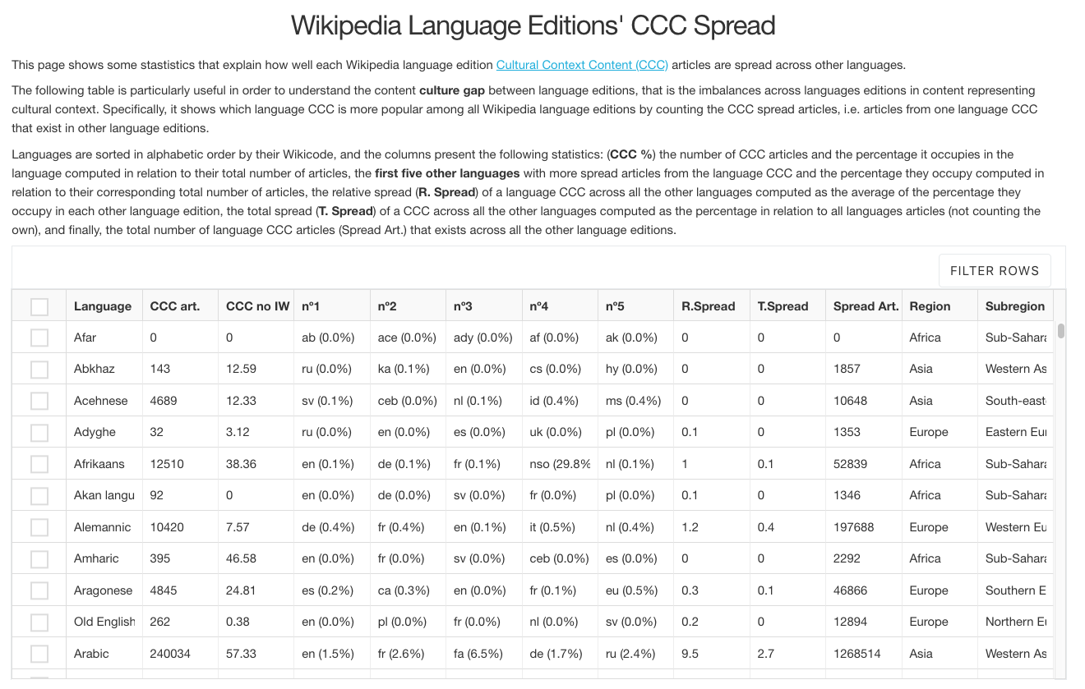
What is the weight of each language CCC in other languages? (Spread)
https://wcdo.wmflabs.org/ccc_spread

Slide 38
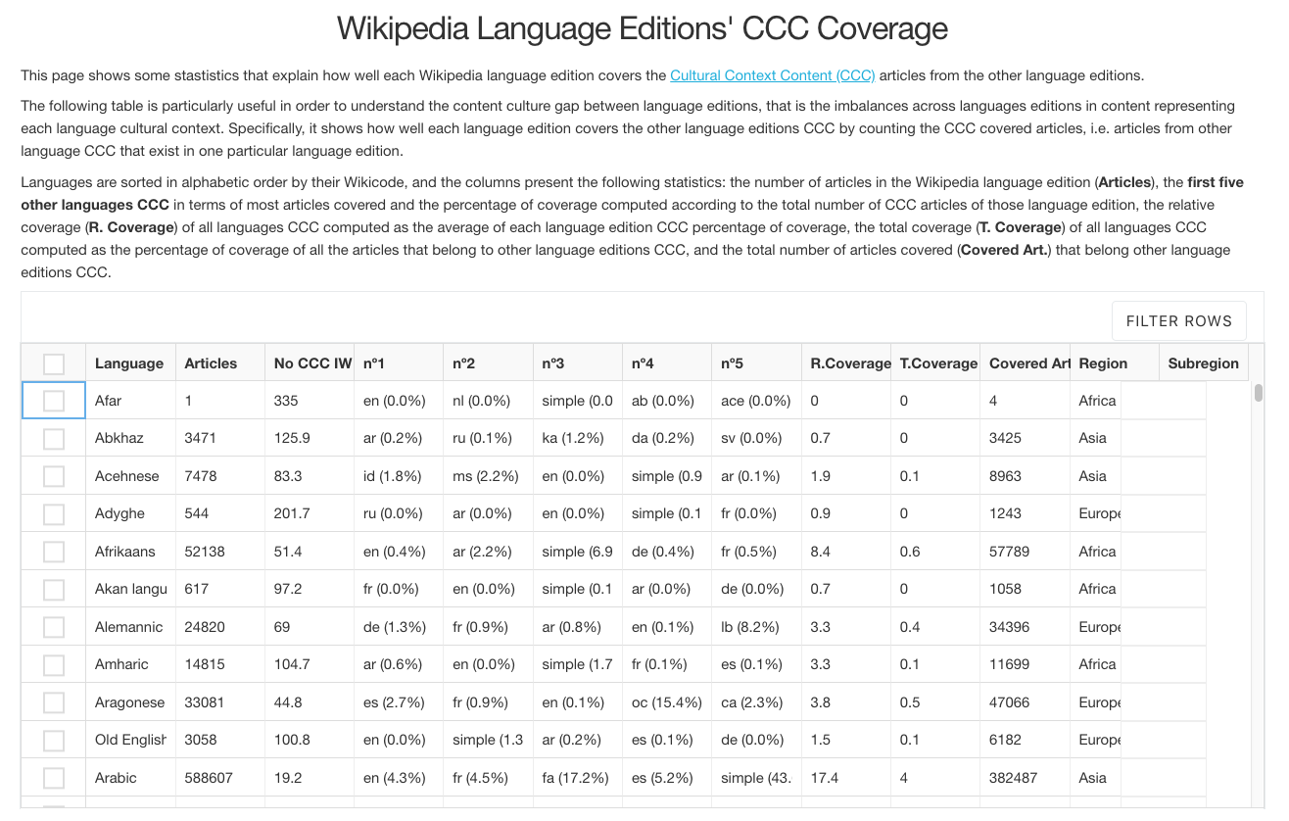
How well do language editions cover other languages’ CCC? (Coverage)
https://wcdo.wmflabs.org/ccc_coverage

Slide 39
Conclusions
We possibly cannot bridge all the gaps… but we can focus on the Top CCC articles lists.
You can dig so much into what is valuable to your context.
TV Shows, Monuments, Political figures…?
…
Notes:
In my research, I selected the content related to the cultural contexts of the editors from each language version, and then I studied characteristics such as topics and availability between linguistic versions, the editing activity, among others.
I found that the Cultural Context Content (CCC) represents on average a quarter of each Wikipedia language edition, dealing with topics such as culture, politics, people or geography of its speaking territories.

Slide 40
The big Wikipedias should aim at covering the minimum of each others’ cultures. I am more concerned about the Top CCC articles gap than the entire Culture Gap.
The small Wikipedias should aim at creating articles that might fill the lists of Top CCC articles. This is the first group of articles the world should care about.

Slide 41
The big Wikipedias
Create 100 articles for each language edition CCC.
We should reach this minimum amount.
Few results not represented (yet):
CCC % in terms of pageviews is always bigger than CCC % articles.
The Top 500 CCC articles in terms of pageviews are 20-50% of the pageviews in CCC.
Notes:
CCC MATTERS.

Slide 42
The small Wikipedias
Create 100 articles for each CCC segment so they appear in the lists
By segment it means: geolocated articles, keywords on title (demonym and territory name), women and men.
Represent your own culture, at least the most important parts.
Let’s create a virtuous circle!
Notes:
For this, I propose to create a site named Wikipedia Cultural Diversity Observatory (WCDO), where to provide automated rich statistics and visualizations on the current state of diversity, cultural context content datasets for each language edition as well as pointing out solutions in order to improve the exchange of content across Wikipedia language editions.
One important solution is a list of articles for each Wikipedia language edition CCC by order of priority (algorithmically computed according to valuable metrics such as extension, quality and editor engagement metrics) which should exist in any other Wikipedia language edition. The list could highlight the first 100, although big Wikipedias may have more than 100 articles which should be reasonably present in all other languages.
This Top 100 in particular would ensure that each Wikipedia language edition has a minimal and strategical coverage of the whole available Wikipedia project cultural diversity.

Slide 43
I am going to give you a Control Panel
Notes:
In my research, I selected the content related to the cultural contexts of the editors from each language version, and then I studied characteristics such as topics and availability between linguistic versions, the editing activity, among others.
I found that the Cultural Context Content (CCC) represents on average a quarter of each Wikipedia language edition, dealing with topics such as culture, politics, people or geography of its speaking territories.

Slide 44
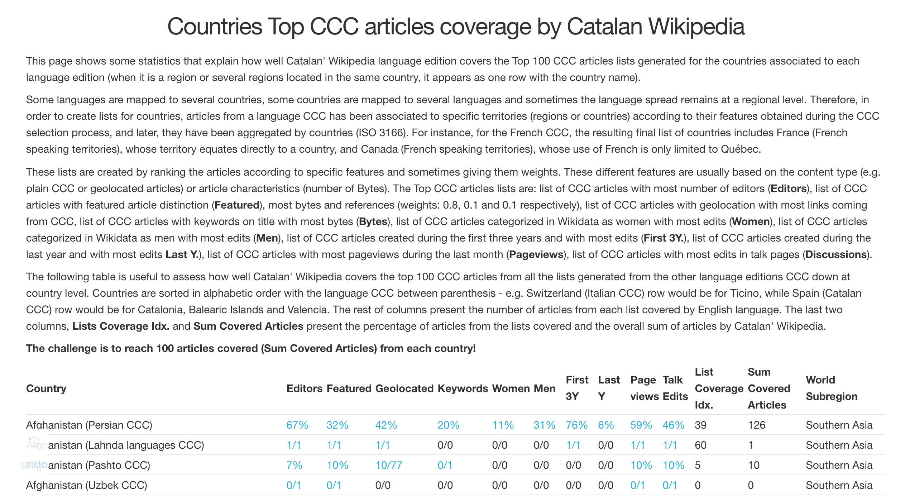
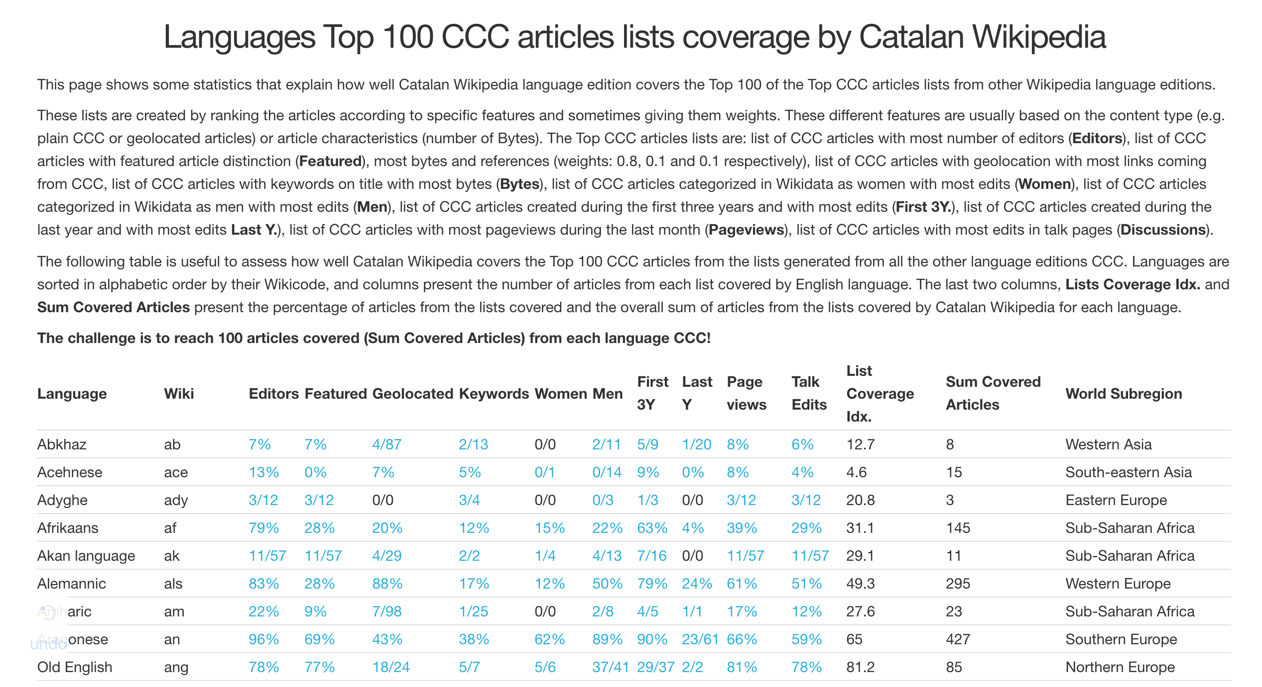
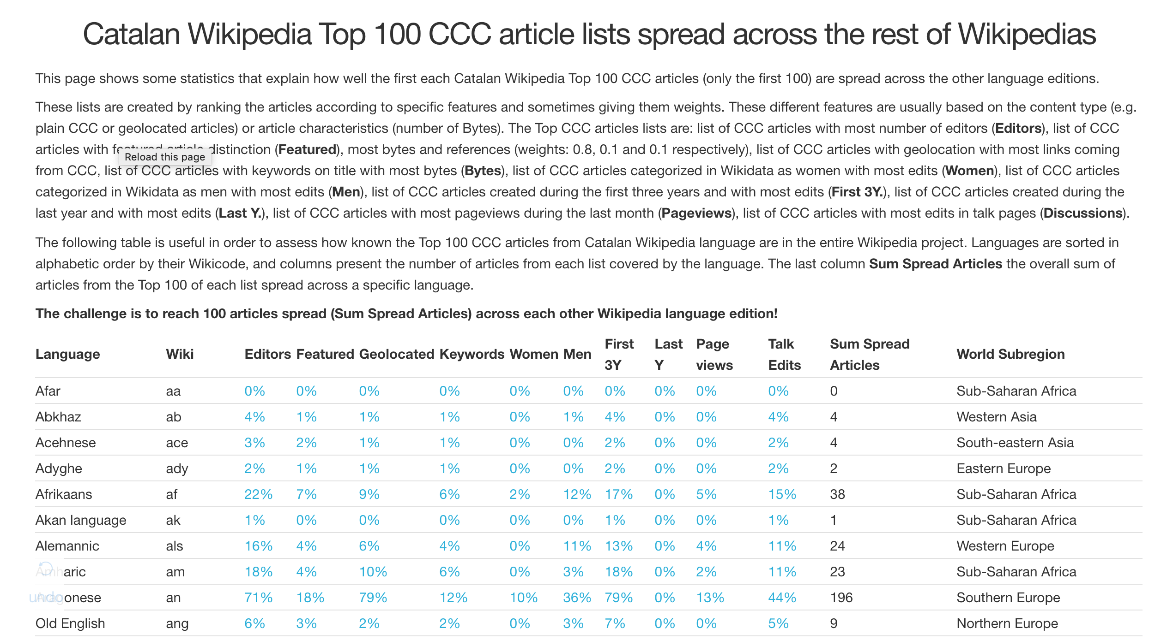
I am going to give you three Control Panels
Notes:
In my research, I selected the content related to the cultural contexts of the editors from each language version, and then I studied characteristics such as topics and availability between linguistic versions, the editing activity, among others.
I found that the Cultural Context Content (CCC) represents on average a quarter of each Wikipedia language edition, dealing with topics such as culture, politics, people or geography of its speaking territories.

Slide 45
How do languages cover each others Top CCC articles?
These are panels to obtain a general view on the coverage and spread of the Top CCC.
Languages Top CCC articles coverage
https://wcdo.wmflabs.org/languages_top_ccc_articles_coverage/?lang=ca
Countries Top CCC articles coverage
https://wcdo.wmflabs.org/countries_top_ccc_articles_coverage/?lang=ca
Languages Top CCC articles spread
https://wcdo.wmflabs.org/languages_top_ccc_articles_spread/?lang=ca
Lang = wikicode
Notes:
In my research, I selected the content related to the cultural contexts of the editors from each language version, and then I studied characteristics such as topics and availability between linguistic versions, the editing activity, among others.
I found that the Cultural Context Content (CCC) represents on average a quarter of each Wikipedia language edition, dealing with topics such as culture, politics, people or geography of its speaking territories.

Slide 46
Future steps
There are several possibilities for improving WCDO mainly from the data analysis and visualization point of view. The project has just set its base and now it would be time to think of further implementations:
Pageviews (what is the extent of pageviews in CCC in every language?).
Topical coverage (what topics are in each CCC, religion, sport, history…?).
Temporal tracking of the gaps (are we doing better this year than the previous?).
Past month (are we dedicating efforts to languages that require it?).
Maps and reports for geolocated articles coverage (where are the gaps?).
Editors (who creates CCC, anonymous or admins?).
Monthly Newsletter with popular CCC articles.
Please, answer in the survey (at the end of the page): https://wcdo.wmflabs.org
https://meta.wikimedia.org/wiki/Wikipedia_Cultural_Diversity_Observatory/Get_involved

Slide 47
Closing: WCDO Goals
Every Wikipedia language community is aware and knows about the knowledge inequalities in the entire Wikipedia project.
Every Wikipedia language edition ensures a minimal coverage of each other language cultural and geographical content.
Every Wikimedia event includes sections and activities dedicated to mitigate the cultural knowledge gaps and derived knowledge inequalities.
Every Wikimedian is able to understand better her own cultural context and its representation on her home language edition.
Every Wikimedian values the importance of representing her own culture so the rest of language editions users can import and learn from it.
Notes:
For this, I propose to create a site named Wikipedia Cultural Diversity Observatory (WCDO), where to provide automated rich statistics and visualizations on the current state of diversity, cultural context content datasets for each language edition as well as pointing out solutions in order to improve the exchange of content across Wikipedia language editions.
One important solution is a list of articles for each Wikipedia language edition CCC by order of priority (algorithmically computed according to valuable metrics such as extension, quality and editor engagement metrics) which should exist in any other Wikipedia language edition. The list could highlight the first 100, although big Wikipedias may have more than 100 articles which should be reasonably present in all other languages.
This Top 100 in particular would ensure that each Wikipedia language edition has a minimal and strategical coverage of the whole available Wikipedia project cultural diversity.

Slide 48
Get Involved
Some existing projects that may benefit from WCDO:
Wikimedia CEE Spring
Intercultur Wikimedia España
WikiArabia
Systemic bias project (English, Deutsch, Esperanto, Arabic, Dutch and Russian)
Catalan Culture Challenge
Project dissemination is always welcome!
https://meta.wikimedia.org/wiki/Wikipedia_Cultural_Diversity_Observatory/Get_involved
Notes:
For this, I propose to create a site named Wikipedia Cultural Diversity Observatory (WCDO), where to provide automated rich statistics and visualizations on the current state of diversity, cultural context content datasets for each language edition as well as pointing out solutions in order to improve the exchange of content across Wikipedia language editions.
One important solution is a list of articles for each Wikipedia language edition CCC by order of priority (algorithmically computed according to valuable metrics such as extension, quality and editor engagement metrics) which should exist in any other Wikipedia language edition. The list could highlight the first 100, although big Wikipedias may have more than 100 articles which should be reasonably present in all other languages.
This Top 100 in particular would ensure that each Wikipedia language edition has a minimal and strategical coverage of the whole available Wikipedia project cultural diversity.

Slide 49
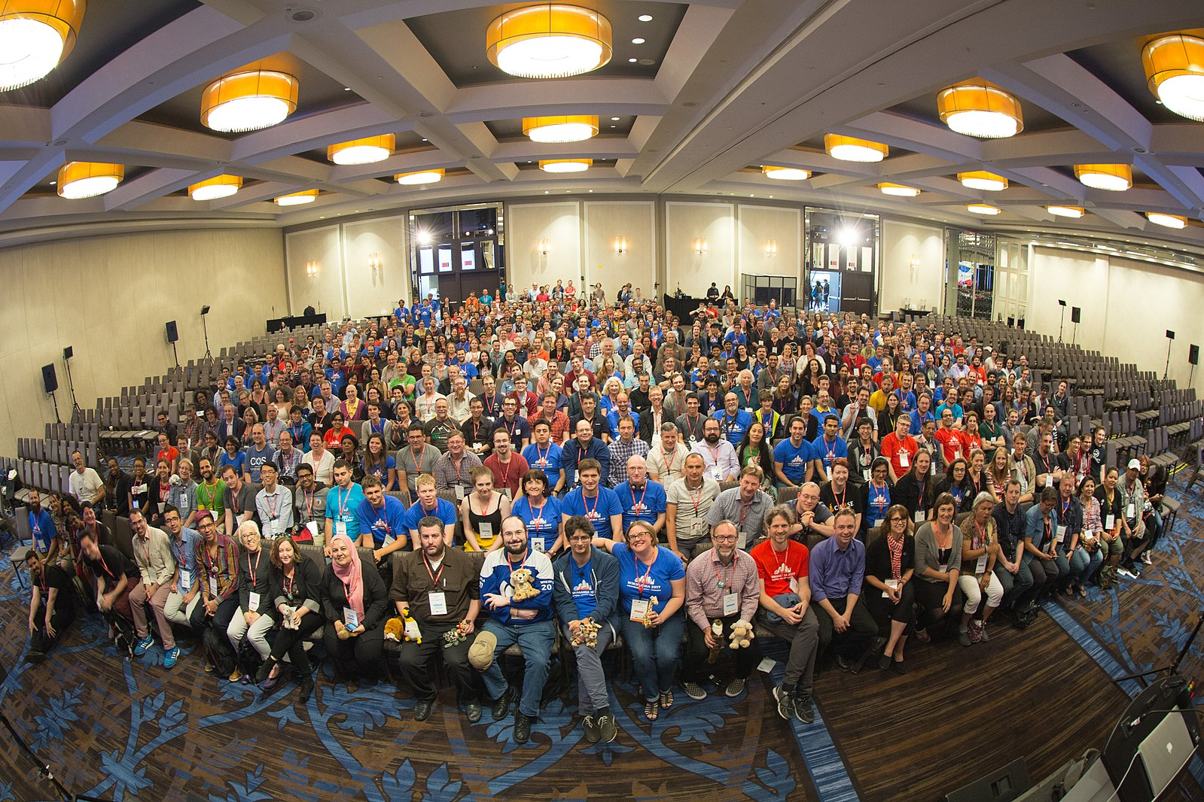
There is nothing more Wikimedian than multiculturality.
Embrace it, collaborate across languages and exchange your cultural context content with others.

Slide 50
Wikipedia Cultural Diversity Obsevatory
(WCDO)
[https://meta.wikimedia.org/wiki/WCDO]
Marc Miquel, PhD
{marcmiquel@gmail.com}
Username:marcmiquel
Pompeu Fabra University, Barcelona, Catalonia
Amical Wikimedia (Catalan Wikipedia)
October 13th 2018 Lviv, Ucraine

Slide 51
Thank you very much!
Marc Miquel, PhD
{marcmiquel@gmail.com}
Username:marcmiquel
Pompeu Fabra University, Barcelona, Catalonia
Amical Wikimedia (Catalan Wikipedia)
March 18th 2018 Tunis

Slide 52

References (if you want to know more)
Miquel-Ribé, M., & Laniado, D. (2016, July). Cultural identities in wikipedias. In Proceedings of the 7th 2016 International Conference on Social Media & Society (p. 24). ACM.
Miquel-Ribé. M. (2017). Identity-based motivation in digital engagement: the influence of community and cultural identity on participation in wikipedia (Doctoral dissertation, Universitat Pompeu Fabra).
Miquel-Ribé, M., & Laniado, D. (2018). Wikipedia Culture Gap: Quantifying Content Imbalances Across 40 Language Editions. Frontiers in Physics, 5, 12. (CC BY) Open Access.
Greetings to:

